Slide 1
Ansible training
Harry Toolseram & Nitin Vig
July 2017

Slide 2
Agenda
Network Automation Landscape
Ansible – What, How, When, Where, Why
Ansible building blocks
Lab: Setup & initial router interaction

Slide 3
Network Automation Landscape

Slide 4


Network Automation: How do we get there?
Building an evolution path
Day 1
Day 2
Day N
Human-driven automation
Event-driven automation
Machine-driven automation
Establish standard-based network interfaces and data models
Automate network provisioning & management
Simplify network operations
Gather network information (Telemetry)
Use network information to make decisions
Rule-based action on network events
(Closed loop automation)
Use machine-learning tools to train the system
Machines makes decisions and drives network change
Humans make decisions where machines cannot
Notes:
We need to break this problem down into smaller phases. The first phase is Day1 Automation. This is where you should look at getting started. It lays the foundation for the sophisticated Automation that you want to build for your organization.
Day1 Automation lets you ease into the Automation transformation journey. It targets the low-hanging fruits such as communicating with devices using standards-based interfaces, using tools or writing scripts to automate device provisioning, automating daily operation tasks. There is a famous story about how Jeff Besos wrote an internal memo around 2002 mandating all the engineering teams to use only service APIs to communicate with customers and across teams. This change was fundamental in Amazon making the shift from being a ‘book seller’ to world’s largest ‘Cloud infrastructure provider’. Therefore importance of this step cannot be overstated.
This phase is also referred to as Human-driven automation because the Human instructs the machine to perform certain tasks in a programmatic way. Also, in most cases the communication here is one-way or open-loop from the Human to the machine.
The next phase is Day2 or Event-driven automation. Once we have provisioned a device with Day1 automation and it is in service, we want to collect information from this device to understand how it is performing and to fine-tune its performance as required. So we build a closed-feedback-loop between the machine and the human. The device sends data on key metrics using telemetry and we use automation to detect events based on these metrics and take action on these events. While this may seem like a fully automated cycle where there is no role for the Human, the Human actually plays an important role here to build the Rule-based logic that drives this engine. This phase elevates the role of the Human as the brain that ties the events to business logic and builds rules that determine the action to be taken on these events.
The next phase in this evolution is Day N or Machine-driven automation where machines are not just taking actions on the defined rules, they are laso defining the rules. Ofcourse, they do call in the Human when they get stuck and don’t know what to do.
So, this is how the Network Automation will evolve, now lets look at the tools that will make this happen.

Slide 5



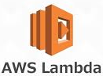













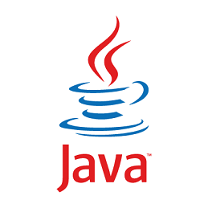










Automation Technologies - Landscape
YANG
Notes:
Automation, DevOps, Machine learning, Artificial intelligence are all somewhere along their journey on the Gartner hype-cycle and as is always the case with any technology on the hype-cycle, there is a soup of tools and buzzwords that surround it. This is another one of those soups that lists some of the important tools that in relation to Automation.

Slide 6
Automation Technologies - Landscape
Day 1
Day 2
Day N
Supervised learning
Unsupervised learning
Reinforcement learning
Deep learning
YANG
Notes:
Let’s try to classify these tools into the phases that we just discussed. Now, if you a familiar with some or all of the tools, you would notice that this classification is not perfect. For example, one could argue that technologies ilke YAML and XML are more foundational and are not specific to any phase or that scripting languages like Python & Ruby have a role to play in Day 1, Human-driven automation. The point of this slide is to provide some high-level guidance on which tools and technologies to focus on during Day1, Day2 or DayN of your Automation journey. Your mileage may vary.

Slide 7
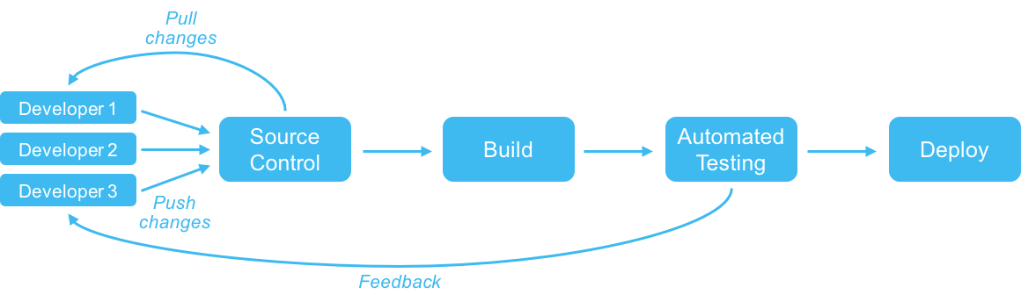


Infrastructure as Code: Adopting software methodology
Continuous Deployment
Continuous Integration
Application 1
Release Management
Or
Application as Code
Application 2
Application 3
Config
Middleware
Configuration Management
Or
Infrastructure as Code
OS
BARE METAL
Application is code, Test is code, Infrastructure is ‘also’ code
Notes:
The software development houses have been following the software lifecycle methodologies for a long-time to consistently churn out quality code. This processe has evolved over time from the traditional Waterfall methodology to an Agile based methodology. Now this Agile methodology is being combined with learnings from the DevOps revolution. The impact of this change has been very positive on the software development industry and its helped to improve the quality and velocity at which code is churned and reduce the risk.
This increased velocity and reduced risk has been made possible by using concepts like Source control, Continuous Integration and Continuous Delivery that help organizations to build a repeatable, self-sustaining software development pipeline.
===Optional (TL;DR)===
The pipeline begins with the build process where the developer commits code to the source control repository. Source control has been around for a while, however the processes around it are changing with the DevOps mentality. The idea is to have a single branch of code (not multiple code branches) that received regular commits in small batches. These changes go through a continual and automated test process and the results of the tests are fed back to the developer. This is the Continuous integration process. Once the build passes testing, it is automatically deployed into production through the Continuous Deployment process.
The developer is responsible for the entire lifecycle from writing code to write tests, to fixing bugs and supporting production.
===/Optional===
What you get at the end of this process is the Application that gets deployed in production. Typically the software development lifecycle ends here. However, this entire lifecycle works on the assumption that the infrastructure required to support the effort is already available for use. This assumption has been a cause of frustration because it is flawed. As we all know, setting up Datacenter infrastructure does not happen overnight and it can sometimes derail the complete delivery schedule. The solution to this problem is Configuration management or ‘Infrastructure as code’. The idea is pretty simple. Treat your infrastructure just like you treat your code. Build a repeatable, self-sustaining pipeline for your infrastructure build up just like you would for your software. Tools such as Puppet, Chef, Ansible and Saltstack help you to automate the entire process of building up your server infrastructure right from the bare metal server to the OS, middleware and their dependencies. This significantly changes how we look at Datacenter infrastructure deployment and takes out a major bottleneck in bringing features to customers faster.
So, now we have the entire stack sorted all the way from the bare metal server to the delivery of the application. But what about the network?

Slide 8
Infrastructure as Code: For the Network
Build
Collaborate and create new configurations
Test
Validate configurations in physical or virtual lab
Demo
Deploy
Deploy new configurations in production
Validate
Validate network behavior after configuration
Monitor
Continuously monitor and provide feedback

Slide 9
Ansible: What, How, When, Where, Why?

Slide 10
What is Ansible?
It’s science fiction:
An ansible is a category of fictional device or technology capable of instantaneous or faster-than-light communication. It can send and receive messages to and from a corresponding device over any distance or obstacle whatsoever with no delay.
A radically simple IT automation platform
Ansible’s goals are similar to other tools such as Puppet, Chef and Saltstack
Created by Michael DeHaan
Initial release in 2012
Current release is 2.3.1.0 (July 2017)
Acquired by Red Hat in 2015
It is very popular!

Slide 11
Why Ansible?
Agent-less
Low risk (Run it locally)
Push-based
Easy to learn & use (Abstraction)

Slide 12
Why Ansible?
Comparing with Puppet and Chef:
No Master server → running from everywhere (laptop)
No Agent on device →only require SSH
Configuration in Yaml
Very easy to learn
Written in Python, use Jinja2
Ansible is the most adopted by our customers

Slide 13
Where is Ansible used?
Initially for servers and applications
Ansible is designed for performing actions (tasks) on multiple servers.
Ansible uses cases are:
Application deployment
Configuration management
Template management
Orchestration
Ad-hoc task execution (execute a command across some hosts)
Some nice network automation capabilities added recently.

Slide 14
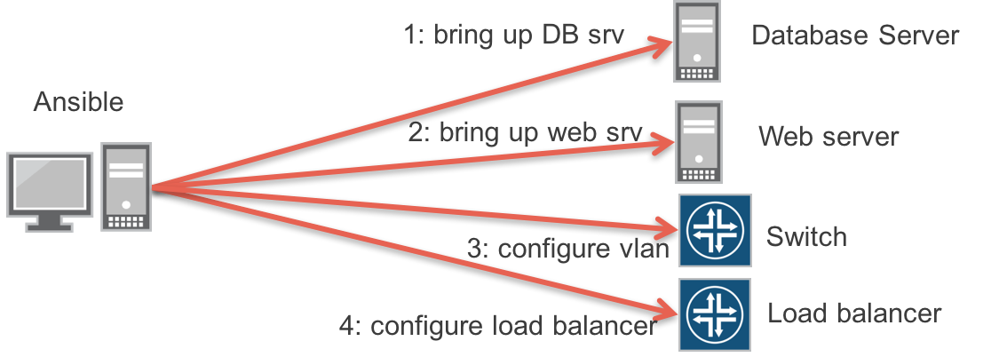
Example: Orchestration with Ansible
Where is Ansible used?
Manipulate an entire multi-tier application stack:
Bring up the database before bringing up the web servers
Take web servers out of the load balancer one at a time for hitless upgrades
Configure networks have their proper VLANs and IP addresses

Slide 15
Where is Ansible used?
For Juniper devices
1
Generate and Deploy Configuration
5
Initial config via console (ZTP)
2
Upgrade devices
6
Manage devices through LRM
3
Save/reapply configuration
7
Deploy VM/Container
4
Convert VCF -> Standalone
8
All at the same time

Slide 16
Contrail 4.0 example?
Where is Ansible used?

Slide 17



How does Ansible work?
Server
Ansible
Shell
HTTP
REST API
Console
Laptop
Server
SSH/NETCONF
Network devices
Or server

Slide 18
How does Ansible work?
CMDB
PUBLIC / PRIVATE CLOUD
ANSIBLE’S AUTOMATION ENGINE
USERS
INVENTORY
API
HOSTS
MODULES
PLUGINS
NETWORKING
ANSIBLE PLAYBOOK

Slide 19
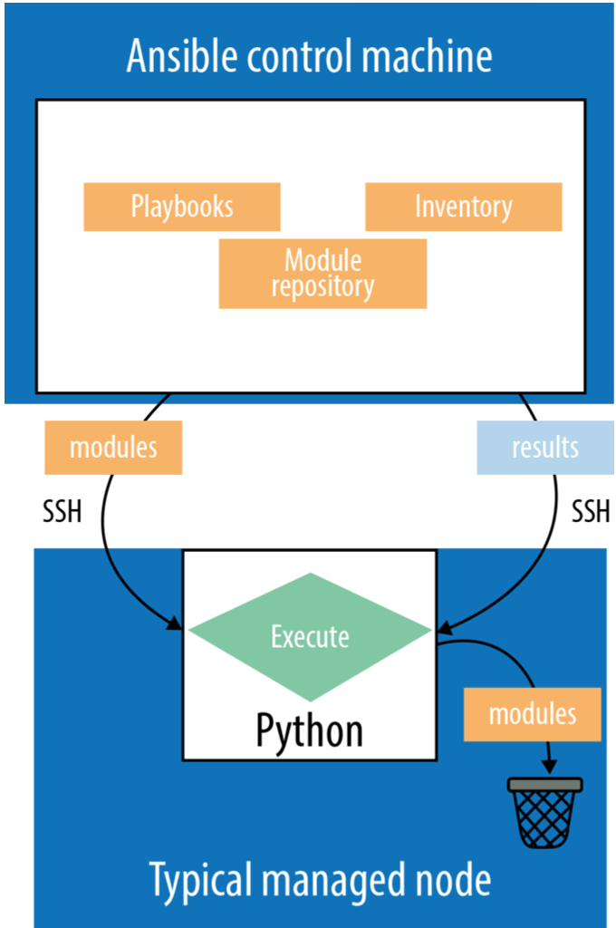
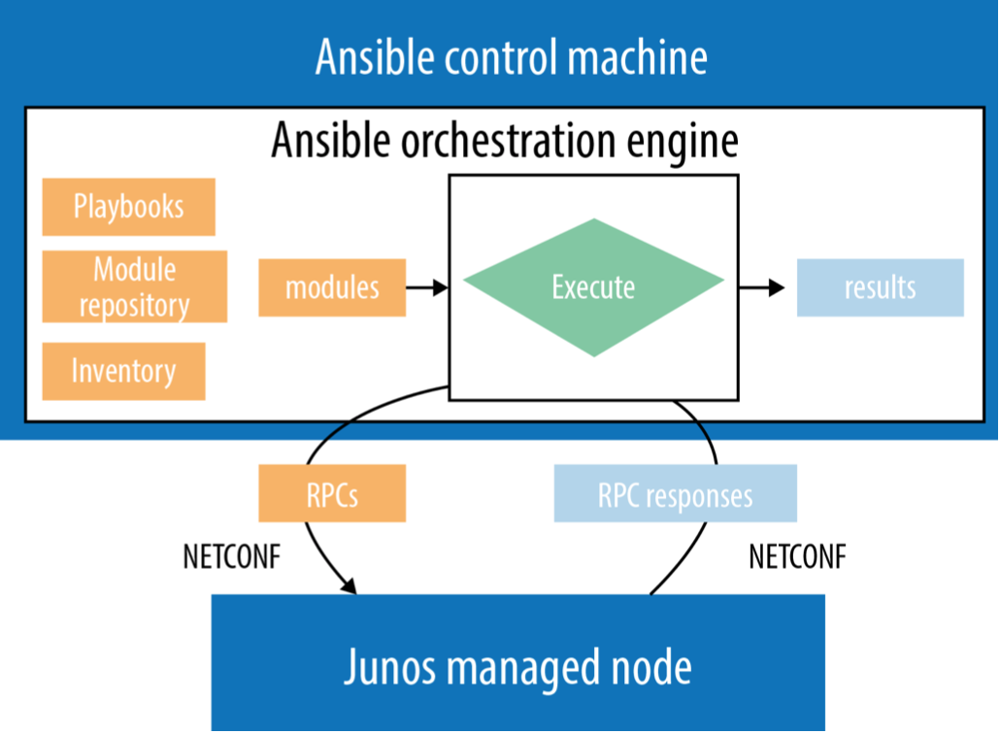
How does Ansible work?
Standard mode
API mode
Transport python modules to remote boxes using SSH
Execute the python modules and then eliminate them from remote hosts
Modules run on Ansible server. Uses channel/API (Netconf ....) to change device configs.
“connection: local” in the playbook

Slide 20
ANSIBLE AND PYTHON
Ansible is written in Python.
All Ansible core modules are written in Python
No need to know Python to use Ansible
You can use ansible without understanding the python modules!
Unless you want to write your own modules to extend Ansible capabilities.
Ansible uses Python 2.7
Python 3 is not compatible with Ansible
When you install Ansible, it installs automatically these Python modules:
paramiko (Ansible manages machines over SSH)
PyYAML (you interact with Ansible in yaml)
Jinja2 (Ansible has builtin templating capabilities)
httplib2 (a comprehensive HTTP client library)

Slide 21
ANSIBLE AND PYTHON
Once you have mastered Python, Jinja2, YAML, PyEZ, JSON, Ansible is an excellent next step!
Ansible uses all of them. With some level of abstraction.
All Ansible core modules are written in Python
PyEZ to interacts with Junos devices
Jinja2 to build documents based on templates
YAML is also used to defines variables values
YAML is used to write Ansible playbooks (Ansible scripts)
Ansible expects modules to output JSON

Slide 22
Ansible building blocks

Slide 23
Ansible Building blocks
1
2
Variables
Inventory
3
4
Playbooks
Modules
5
Roles

Slide 24
1/ Inventory file and Group
Simple text files which describe your servers/devices.
You can have many inventory files
IP Addresses or DNS Names grouped by names.
Default ansible 'hosts’: /etc/ansible/hosts
Groups of hosts (per device type, per location, ...)
A hostname/ip can be a member of multiple groups
[spine]
qfx10002-01
qfx10002-02
[leaf]
qfx5100-01
qfx5100-02
qfx5100-03
qfx5100-04

Slide 25
[all:children]
spine
leaf
[spine]
qfx10002-01 junos_host=192.168.0.1
qfx10002-02 junos_host=192.168.0.2
[leaf:children]
rack01
rack02
[rack01]
qfx5100-01 junos_host=192.168.0.3
qfx5100-02 junos_host=192.168.0.4
[rack02]
[..]
[qfx10000]
qfx10002-01
qfx10002-02
[qfx5100]
qfx5100-01
qfx5100-02
[siteA]
qfx10002-01
[..]
qfx5100-01
Simple but very powerful.
One device can be part of multiple groups
Can have a hierarchy of groups
Inventory files can take advantage of variables and enumerations
Can groups devices by type/position/roles etc …

Slide 26
[all:children]
spine
leaf
[spine]
qfx10002-01 junos_host=192.168.0.1
qfx10002-02 junos_host=192.168.0.2
[leaf:children]
rack01
rack02
[rack01]
qfx5100-01 junos_host=192.168.0.3
qfx5100-02 junos_host=192.168.0.4
[rack02]
[..]
[qfx10000]
qfx10002-01
qfx10002-02
[qfx5100]
qfx5100-01
qfx5100-02
[siteA]
qfx10002-01
[..]
qfx5100-01
qfx10002-01 is part of groups:
all
spine
qfx10000
siteA
qfx5100-01 is part of groups:
All
leaf
rack01
qfx5100
siteA

Slide 27
Ansible Concepts
1
2
Variables
Inventory
3
4
Playbooks
Modules
5
Roles

Slide 28
2/ Variable file
A simple YAML file accessible from templates and playbooks
A variable file is a simple YAML file
Accessible from templates and playbooks
global:
root_hash: $1$ZUlES4dp$OUwWoV/aMWpHUnC/
time_zone: America/Los_Angeles
name_servers:
- 192.168.5.68
- 192.168.60.131
ntp_servers:
- 172.17.28.5
snmp:
location: "Site 1"
contact: John Doe
polling:
- community: public
routes:
default: 10.94.194.254

Slide 29
2/ Variables associated with Groups and Hosts
|-- group_vars
| |-- leaf01
| | |-- file1.yaml
| | `-- file2.yml
| |-- leaf02
| | |-- file1.yaml
| | `-- file2.yml
| |-- spine
| | |-- file1.yaml
| | `-- file2.yml
| |-- all.yaml
| |-- qfx10000.yaml
| `-- qfx5100.yaml
|-- host_vars
| |-- qfx10002-01
| | |-- file1.yml
| | `-- file2.yaml
| |-- qfx5100-01
| | |-- file1.yml
| | `-- file2.yaml
[…]
| `-- qfx5100-05.yml
| `-- qfx5100-06.yml
One or multiple variable files possible per
Host
Group
Very flexible
Variables can also be defined in inventory

Slide 30
Generate configuration with Template
Final version
system {
host-name qfx5100-01;
root-authentication {
encrypted-password “$1$dvewqcsarwrgvwr”;
}
}
interfaces {
em0 {
unit 0 {
family inet {
address 10.10.10.1/24;
}
}
}
ge-0/0/0{
unit 0 {
family inet {
address 192.168.0.1/24
}
}
}
ge-0/0/1{
unit 0 {
family inet {
address 192.168.1.1/24
}
}
}
}
protocols {
ospf {
area 0.0.0.0 {
interface ge-0/0/0
interface ge-0/0/1
}
host_vars/qfx5100-01.yaml
system {
host-name {{ inventory_hostname }};
root-authentication {
encrypted-password "{{ global.root_hash }}";
}
}
interfaces {
{{ mgmt_interface }} {
unit 0 {
family inet {
address {{ host.mgmt.ip }}/{{ host.mgmt.mask }};
}
}
}
{% for interface in ospf.interfaces %}
{{ interface }} {
unit 0 {
family inet {
address {{interface.ip }}/{{interface.mask }};
}
}
}
{% endfor %}
}
protocols {
ospf {
area 0.0.0.0 {
{% for interface in ospf.interfaces %}
interface {{ interface }}
{% endfor %}
}
ospf:
interfaces:
ge-0/0/0:
ip: 192.168.0.1
mask: 24
ge-0/0/1:
ip: 192.168.1.1
mask: 24
Host:
mgmt:
ip: 10.10.10.1
mask: 24
group_vars/qfx5100.yaml
Mgmt_interface: em0
group_vars/all.yaml
Global:
root_hash: $1$dvewqcsarwrgvwr
Host:
mgmt:
mask: 24

Slide 31
Ansible Concepts
1
2
Variables
Inventory
3
4
Playbooks
Modules
5
Roles

Slide 32
3/ Playbooks
List of actions/tasks to execute on devices
- name: Create config based on template
template: src=noob.j2 dest={{ junos_conf }}
name: Checking NETCONF connectivity wait_for: host={{ junos_host }} port=22 timeout={{ ssh_timeout }} register: netconf_result ignore_errors: True
name: "Upload configuration by console if NETCONF FAIL" when: netconf_result|failed junos_install_config: host={{ junos_host }} user={{ junos_ssh_user }} passwd={{ junos_pwd_clear }} console="--telnet={{ console_addr }},23" file={{ junos_conf }} overwrite=yes logfile="config/{{ inventory_hostname }}.log”
name: "1 min pause" when: netconf_result|failed pause: minutes=1
name: Checking NETCONF connectivity wait_for: host={{ junos_host }} port=22 timeout={{ ssh_timeout }}
List of actions/task to execute on devices
Written in YAML
Applied on a group
Task can be
Merge files
Render Jinja2 Template
Push configuration on Junos

Slide 33
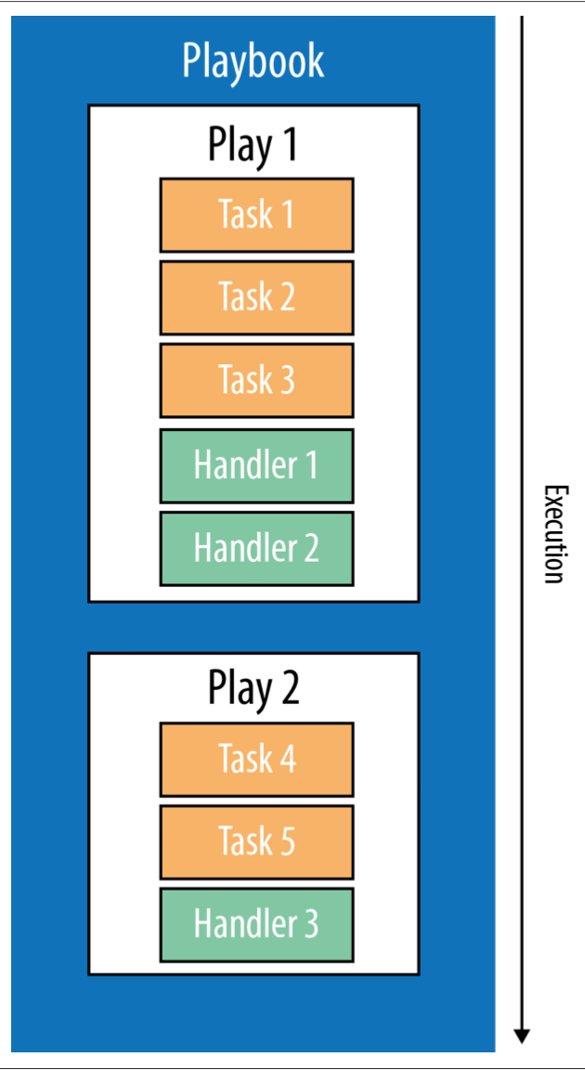
3/ Playbooks > Plays > Tasks
Organizing playbooks into plays and tasks
Playbook is a list of plays
Play has a list of tasks.
A task is a module written in python
Each task has a name.
you can reference the name of a task with the ansible-playbook conmmand and the --start-at-task <task name> option to start the playbook at the task matching this name
Every task contains a key with the name of a module and a value with the arguments to that module.

Slide 34
Ansible Concepts
1
2
Variables
Inventory
3
4
Playbooks
Modules
5
Roles

Slide 35
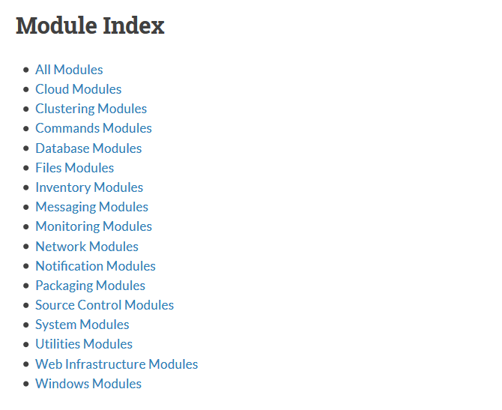
4/ Modules
Extension to easily perform predefine task
Lots of modules available for ansible:
Configure DNS
Configure Database
Install software
Etc …
Most Network Vendor have their Ansible modules…..Including juniper

Slide 36
4/ Juniper Module for Ansible
Module for all Junos devices available
Actively developed and maintained by Junos Manageability team
Support main tasks : Commit, Install, Upgrade, rollback etc …
Current version: 1.4.2 (July 2017)
junos_get_facts — Retrieve device-specific information from the host.
junos_commit — Commit candidate configuration on device.
junos_get_config — Retrieve configuration of device.
junos_install_config — Modify the configuration of a device running Junos OS.
junos_install_os — Install a Junos OS software package.
junos_rollback — Rollback configuration of device.
junos_shutdown — Shut down or reboot a device running Junos OS.
junos_srx_cluster — Enable/Disable cluster mode for SRX devices
junos_zeroize — Remove all configuration information on the Routing Engines and reset all key values on a device.
junos_get_table - Retrieve data from a Junos device using Tables/Views
junos_ping - execute ping on junos devices
junos_jsnapy - Integrate JSNAPy to ansible which helps audit network devices
junos_rpc — To execute RPC on device and save output locally
junos_cli — To execute CLI on device and save output locally

Slide 37
4/ Juniper Module for Ansible
Latest
Stable
Core
Galaxy
Github
junos_facts
junos_config
junos_template(D)
junos_package
junos_rpc
junos_command
junos_netconf
junos_user
junos_get_facts
junos_get_config
junos_install_config
junos_zeroize
junos_install_os
junos_rpc
junos_cli
junos_commit
junos_rollback
junos_shutdown
junos_srx_cluster
junos_get_table
junos_ping
junos_get_facts
junos_get_config
junos_install_config
junos_zeroize
junos_install_os
junos_rpc
junos_cli
junos_commit
junos_rollback
junos_shutdown
junos_srx_cluster
junos_get_table
junos_ping

Slide 38
4/ Juniper Module for Ansible
Latest
Stable
Core
Galaxy
Github
junos_facts
junos_config
junos_template(D)
junos_package
junos_rpc
junos_command
junos_netconf
junos_user
junos_get_facts
junos_get_config
junos_install_config
junos_zeroize
junos_install_os
junos_rpc
junos_cli
junos_commit
junos_rollback
junos_shutdown
junos_srx_cluster
junos_get_table
junos_ping
junos_get_facts
junos_get_config
junos_install_config
junos_zeroize
junos_install_os
junos_rpc
junos_cli
junos_commit
junos_rollback
junos_shutdown
junos_srx_cluster
junos_get_table
junos_ping

Slide 39
4/ Juniper Module for Ansible
Core:
Details: http://docs.ansible.com/ansible/list_of_network_modules.html#junos
Install (along with Ansible): pip install ansible
Galaxy:
Details: https://galaxy.ansible.com/Juniper/junos/
Install: sudo ansible-galaxy install Juniper.junos
Github:
Details: https://github.com/Juniper/ansible-junos-stdlib
Install: git clone https://github.com/Juniper/ansible-junos-stdlib.git

Slide 40
Ansible Concepts
1
2
Variables
Inventory
3
4
Playbooks
Modules
5
Roles

Slide 41
5/ role
Useful to share/reuse the same task across playbook
Roles are used inside Playbook
Very useful to share/reuse the same task across playbook
Also use to access modules
- name: Apply configuration
hosts: all
connection: local
gather_facts: no
roles:
- Juniper.junos
tasks:
- name: Assembling configurations
assemble: src={{ build_dir }} dest={{ junos_conf }}
notify:
- Pushing config ... please wait

Slide 42
5/ Use Roles to leverage existing templates
Useful to share/reuse the same task across playbook
Roles can be leverage to reuse existing configuration templates
It’s a best practice to have roles organized per feature or network function
├── roles
│ ├── junos-system
│ ├── overlay-evpn-access
│ ├── overlay-evpn-mx-l3
│ ├── overlay-evpn-qfx-l2
│ ├── overlay-evpn-qfx-l3
│ ├── underlay-ebgp
│ ├── underlay-ospf
│ └── underlay-ospf-unnumbered

Slide 43
5/ Using Roles and Groups
Useful to share/reuse the same task across playbook
Groups
Roles
All routers
Base config
Edge
Core
Install JUNOS
LDP config
Singapore
Malaysia
Verify BGP

Slide 44
Lab setup

Slide 45
Lab resources
Setup documents, VBox images, Playbooks, Training PPTs
Dropbox (VBox images, setup doc, Training PPTs):
https://www.dropbox.com/sh/jb8niq3b6suvbcg/AAC3cWY_4mGsCWrrF-qY0wtoa?dl=0
Github (playbooks):
https://github.com/vignitin/SG-Ansible-Training

Slide 46
Lab Setup
Setup vboxnet0 interface on Virtual Box:
Under Virtualbox > Preferences > Network > Host-only networks > Add ‘vboxnet0’ interface
Confirm that your localhost has a 192.168.100.x IP:
Import lab topology in Virtual Box:
Import appliance ’ansible-training.ova’
Do not re-initialize the mac-addresses
Lab is setup with the following IPs (change them if required):
vmx0: 192.168.100.100
vmx1: 192.168.100.101
vmx2: 192.168.100.102
Ansible: 192.168.100.103
Inter-VM connectivity & connectivity to localhost should now be setup
vboxnet0: flags=8943<UP,BROADCAST,RUNNING,PROMISC,SIMPLEX,MULTICAST> mtu 1500
ether 0a:00:27:00:00:00
inet 192.168.100.10 netmask 0xffffff00 broadcast 192.168.100.255

Slide 47
Lab Setup: Python, Ansible & Juniper module installation
Install python
Install packages for cryptography dependencies
Install Ansible, PyEZ, JSNAPy and Ansible galaxy Juniper module
sudo apt-get install python
sudo apt-get install python-pip
pip install --upgrade pip
sudo apt-get install build-essential libssl-dev libffi-dev python-dev
sudo pip install ansible
ansible —version
sudo pip install junos-eznc
sudo pip install jsnapy
sudo pip install jxmlease
sudo ansible-galaxy install Juniper.junos

Slide 48
Ansible setup: ansible.cfg
Setting up the permissions
Global: /etc/ansible/ansible.cfg
Local (e.g): $HOME/ansible/playbooks/ansible.cfg
sudo chown -R automation /etc/ansible
sudo mkdir /var/log/ansible
sudo chown -R automation /var/log/ansible
[defaults]
log_path=/var/log/ansible/ansible.log
forks=50
[defaults]
inventory = hosts.ini

Slide 49
Ansible Setup: hosts.ini
Local: $HOME/ansible/playbooks/hosts.ini
[all]
HAN ansible_host=192.168.100.100 loopback_ip=1.1.1.1
SGN ansible_host=192.168.100.101 loopback_ip=2.2.2.2
DAD ansible_host=192.168.100.102 loopback_ip=3.3.3.3
[tesla_vpn]
HAN
SGN
[toyota_vpn]
HAN
DAD
[all:vars]
ansible_user=automation
ansible_ssh_pass=automation123
netconf_port=830

Slide 50
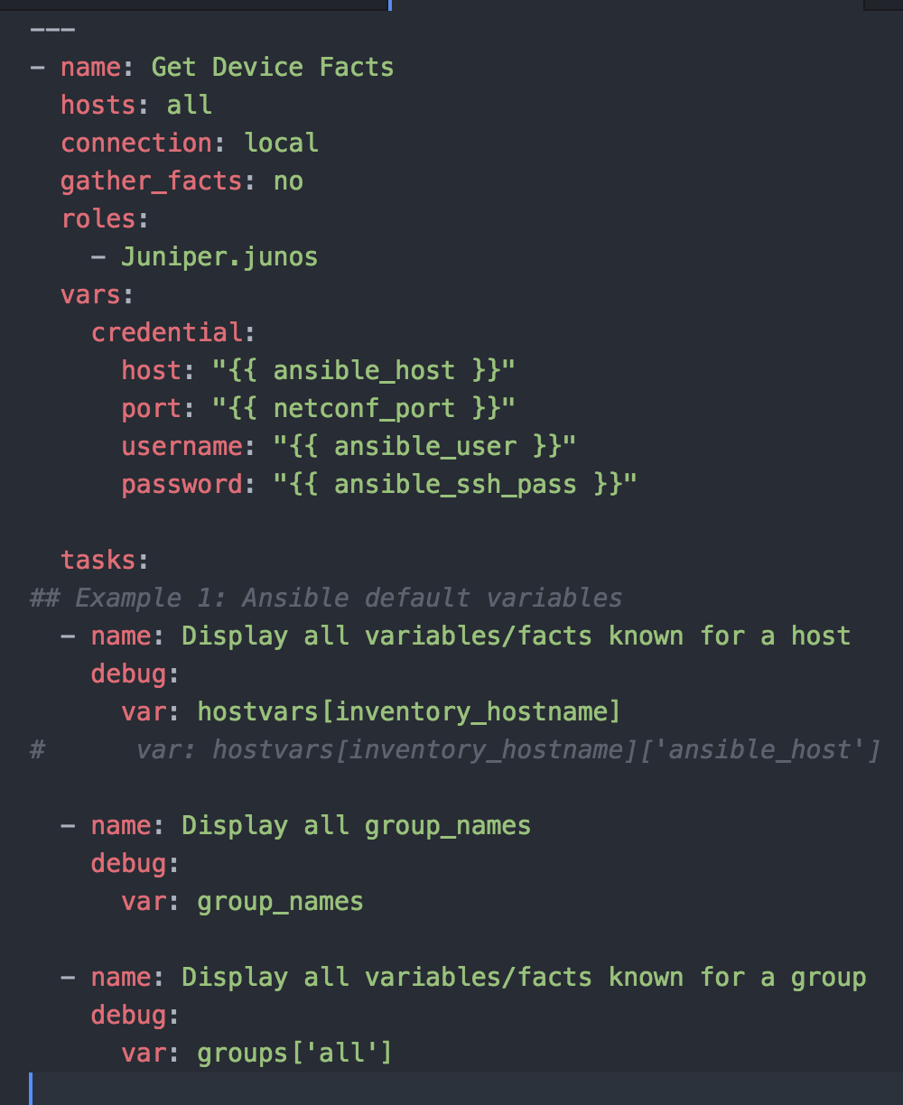
Ansible setup: Our first playbook
Task 1: Get info from Ansible default variables

Slide 51
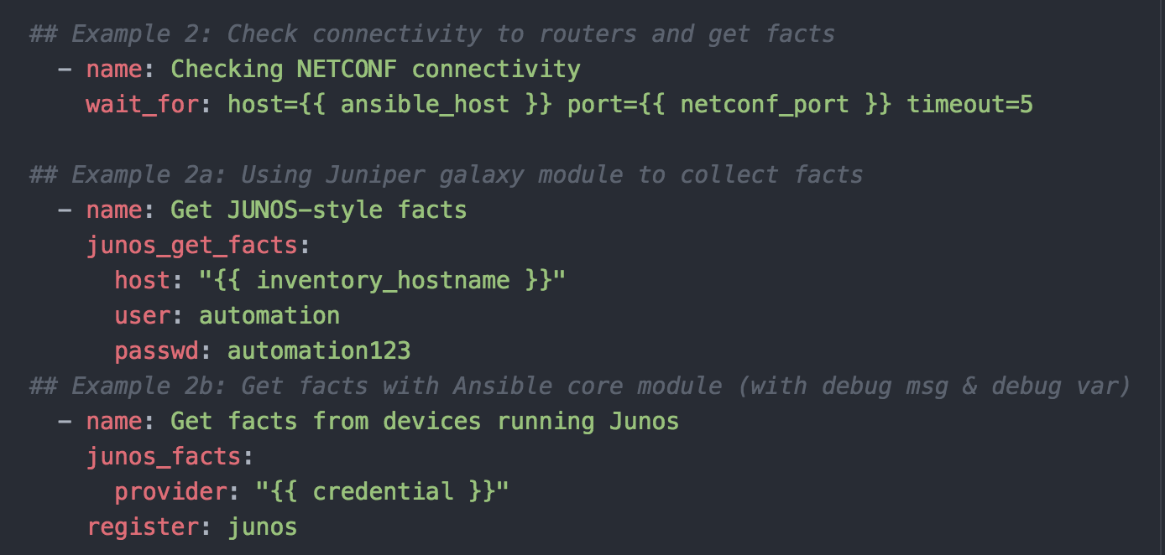
Ansible setup: Our first playbook
Task 2: Check netconf connectivity and get facts from router
Ansible
galaxy module
Ansible
core module

Slide 52
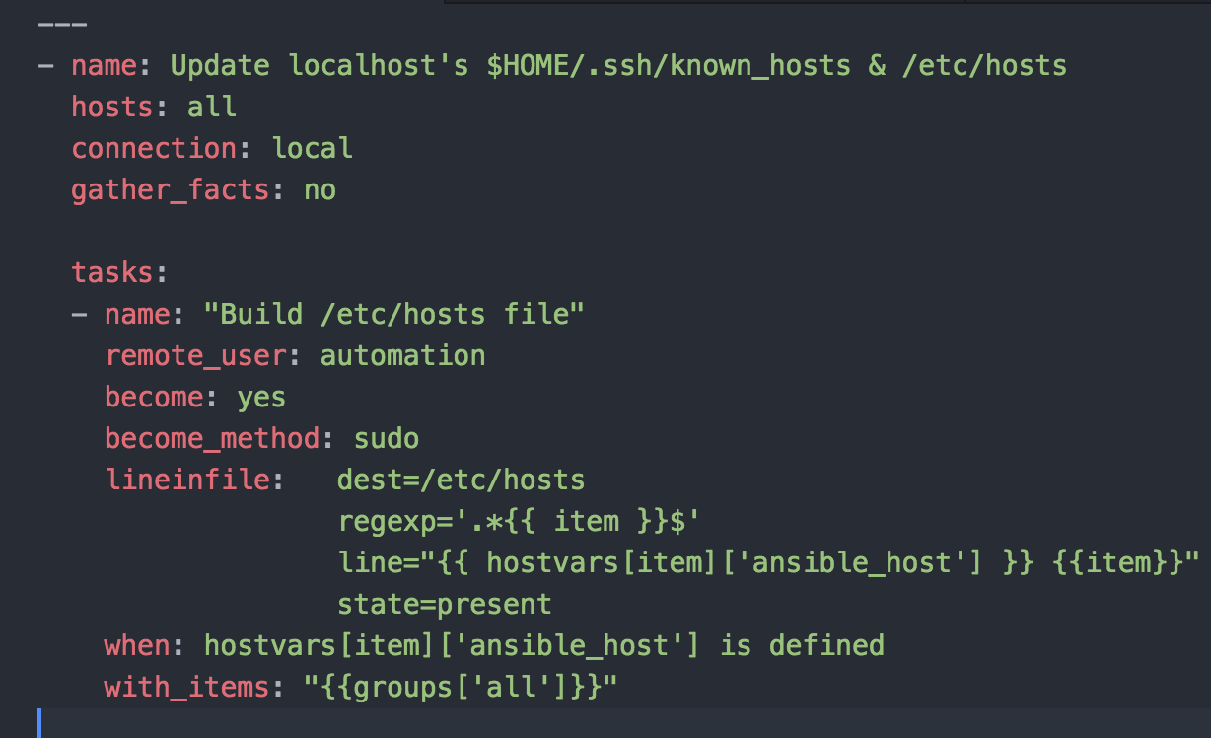
Ansible setup: Our first playbook
Previous tasks may result in UnknownHostName & invalid SSH key type errors
Updating the /etc/hosts & ~/.ssh/known_hosts file using Ansible

Slide 53
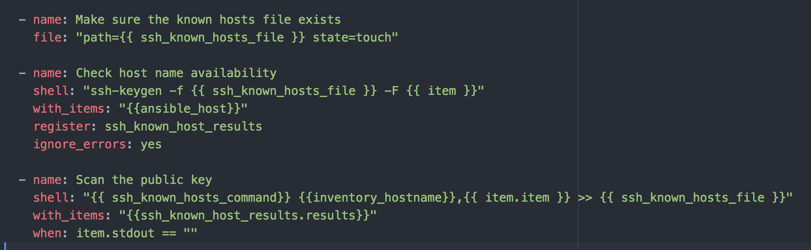
Ansible setup: Our first playbook
Updating the /etc/hosts & ~/.ssh/known_hosts file using Ansible
ansible-playbook pb.conf.localhost.yaml -vv --ask-become-pass
Re-run get facts after updating these files

